Slide 1


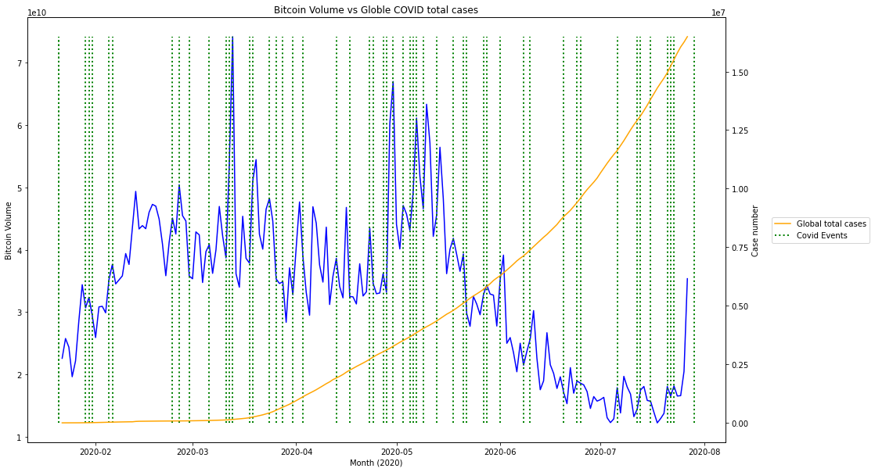
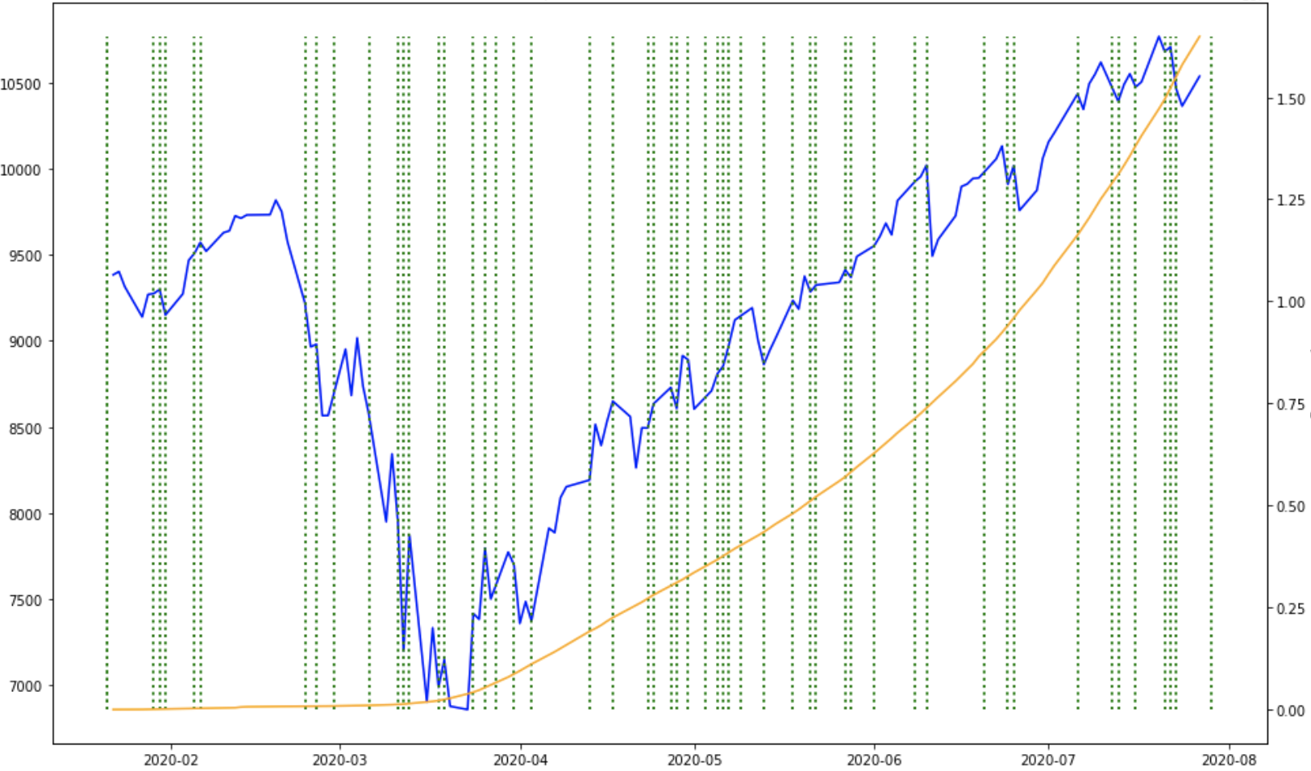
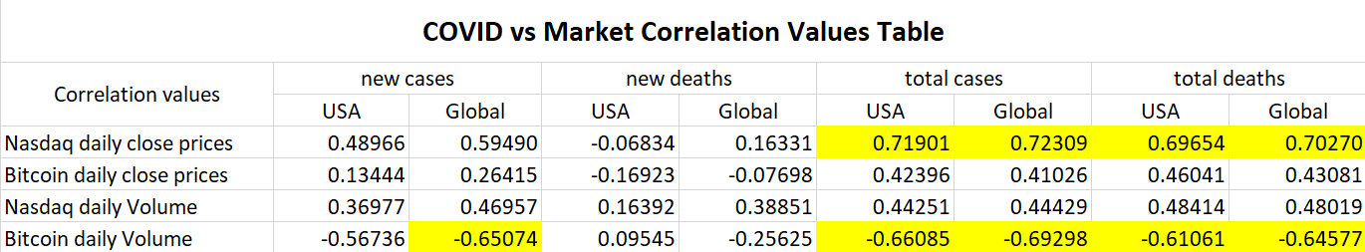


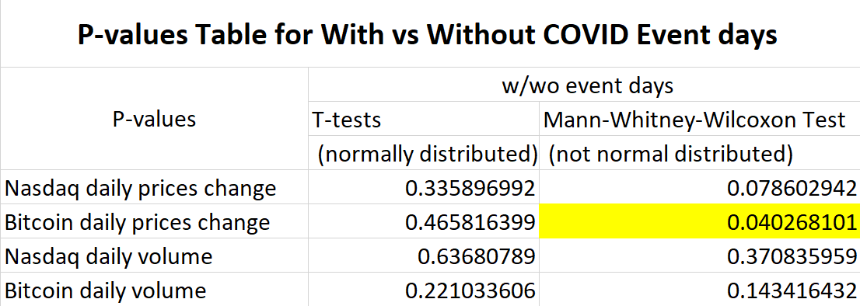
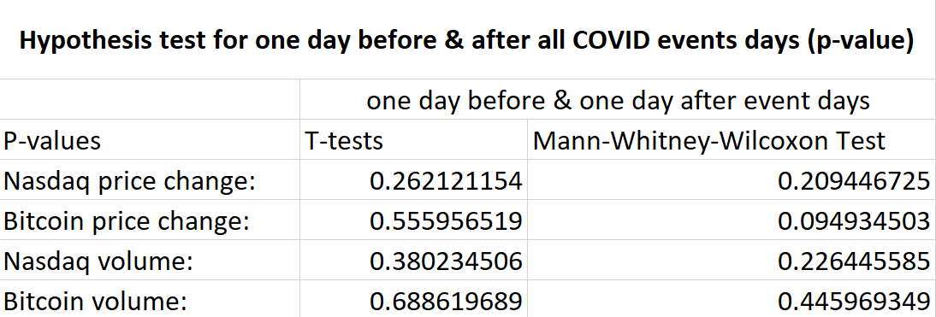
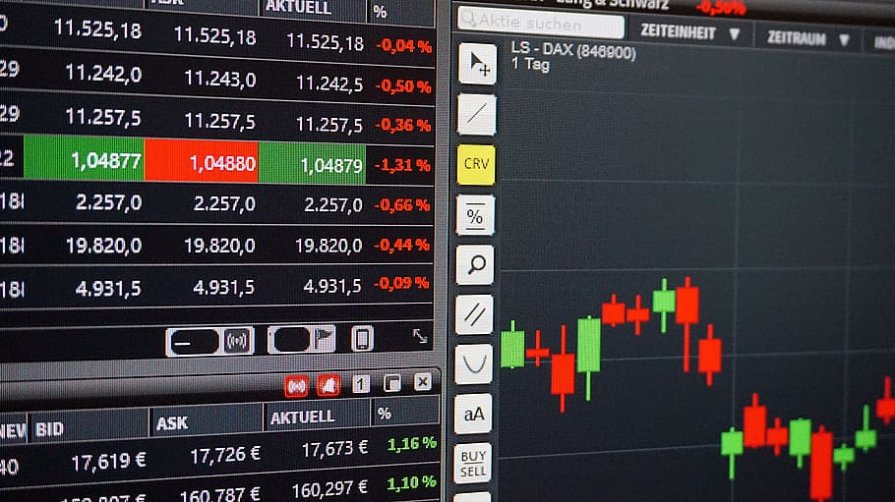
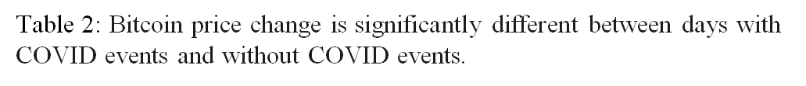
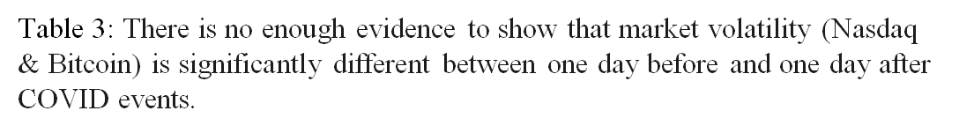
Covid-19’s effects on the Nasdaq & Bitcoin Markets Giovanny Ruiz ¹, Karina Quiroga ¹ ,Maria del mar Del Valle ¹, Weiyuan Wu¹ and Sean Mondesire, Ph.D²
Miami Dade College, Miami, FL ¹
St. Thomas University, School of Science, Miami Gardens, FL²
Problem Statement
COVID-19 vs financial market volatility analysis
Discussion
Has COVID-19 cases and deaths affected the stock and cryptocurrency markets?
Ie10
Bitcoin Volume vs Global Covid-19 total cases
Ie7
Nasdaq Close vs Global Covid-19 total cases
Ie7
Based on the correlation table, Nasdaq daily close prices have a moderate positive relationship with total cases and total deaths (globally and in the USA). Their correlation values are approximately 0.7 and p-values are near zero, which means probabilistically dependent.
Based on the correlation table, Bitcoin daily Volume has a moderate negative relationship with total cases and total deaths (globally and in the USA). Their correlation values range from -0.6 to -0.7 and p-values are near zero which means probabilistically dependent.
There is enough evidence that Bitcoin price change is significantly different between days with COVID events and without COVID events. We can say this because the p-value(0.04027) is below our 0.05 alpha, meaning they are significantly different.
There is not enough evidence to show that market volatility (Nasdaq & Bitcoin) is significantly different between one day before and one day after COVID events. We can say this because the p-values are about our 0.05 alpha, meaning they are not significantly different.
Motivation
The motivation of this study is to identify what has happened to the market due to this pandemic and help others see when and why the market changed.
This will help identify why the stock market has fluctuated these last few months and what event caused it.
This research may help predict what will happen to stocks/bitcoins when COVID-19 [3] cases increase or decrease in the future.
In case of a future pandemic, it will be better known as to what may occur to the stock market as new information arises and as the country responds.
Can help shareholders make decisions about their shares based on past events and fluctuations seen from the research.
___ Global total cases
----- Covid-19 events
___ Bitcoin Price
___ Global total cases
----- Covid-19 events
___ Nasdaq Price
Bitcoin Volume
Case number
Nasdaq Price
Case number
Month
Month
Background
This pandemic hit the world and changed our lives as usual. One thing that has fluctuated since the beginning of the pandemic is the stock market and cryptocurrency.
The stock market serves as an insight of what is going on financially in the companies involved around the globe [4]. Nasdaq [2] index is an aggregated price from all the companies listed in the exchange, and can be used as an indicator as to how the U.S corporations doing in general. Bitcoin [1]is one of the most successful cryptocurrencies in the market, so much that China has started a pilot for their own cryptocurrency.
Fig 1-2: Logos for NASDAQ and Bitcoin [5,6].
Most of the population in the world does not own shares, but are still affected. For example, a non-shareholder individual can have a private pension that invests in the stock market or in cryptocurrency and therefore his/her pension is directly affected
Figure 3:
red color signifies stock price decreases and
green color signifies stock price increases [7].
Conclusions
Our research tested whether COVID-19 events had, in general, an impact on the market volatility. Our research has indicated that there is a significant difference between event days and no event days in Bitcoin price change. Also, we have proven that, based on the correlation table, Nasdaq daily close prices have a moderate positive relationship with total cases and total deaths (globally and in the USA). Lastly, Bitcoin daily Volume has a moderate negative relationship with total cases and total deaths.
Future work: In the next study, we will include more data to exam our hypothesis. We are still in the pandemic, therefore new data and events are becoming available as the overall landscape is ever changing. This future work will analyze pre-, during-, and post- COVID-19 pandemic to built a model of how epidemic disease impact these financial markets.
References
[1] “Bitcoin USD (BTC-USD) Stock Historical Prices & Data”. Accessed on August 24, 2020. https://finance.yahoo.com/quote/BTC-USD/history?p=BTC-USD
[2] “NASDAQ Composite (^IXIC) Historical Data”. Accessed on August 24, 2020. https://finance.yahoo.com/quote/%5EIXIC/history?p=%5EIXIC
[3] Parker, Edward. “COVID-19 tracker”. https://shiny.rstudio.com/gallery/covid19-tracker.html. Accessed on August 24, 2020.
[4] Amadeo, Kimberly. “How the Stock Market Works”. https://www.thebalance.com/how-does-the-stock-market-work-3306244. Accessed on August 24, 2020.
[5] Nasdaq logo. Accessed on august 24, 2020. https://commons.wikimedia.org/wiki/File:NASDAQ_Logo.svg
[6] Bitcoin cryptocurrency icon. Accessed on August 24, 2020. https://www.pikrepo.com/fyhre/illustration-of-bitcoin-cryptocurrency-icon
[7] Trading app screen. Accessed on August 24, 2020. https://www.pxfuel.com/en/free-photo-oyvxp
Methodology
To determine if COVID data and events affect financial markets, the following steps are followed:
1.Financial data, COVID data and COVID related news list are downloaded.
2.Merge price and volume data with COVID-19 data to form a combined date-based table.
3.Day plots were created base on price, volume and case data.
4.Created indexes base on COVID event list and add it to Day plots as vertical lines.
5.Calculate correlation values, do hypothesis tests and make it as tables.
6.Do statistical analysis and get conclusions based on the value tables and graphs.
When more information becomes available through the news, the agents make rational decisions about whether buying or selling assets. Therefore, news can change volumes and prices of the assets by giving relevant information to the agents, so they make decisions according to this data. In order to check if a specific event is relevant enough for the market, we used the Mann-Whitney-Wilcoxon Test for different dates when important information becomes available for the public.
There are statistically significant events, when Covid-related news are released causing changes on Nasdaq traded volumes, such as: first Covid related death in the USA, two million confirmed cases of Covid in USA, President Trump holding a campaign rally against experts' opinions, and California’s governor reverses opening measures. For Bitcoin volumes, the statistically significant events were: Contaminated testing kits for Covid, first Covid-related death in USA, and the stimulus package at the same time of the first one thousand Covid-related deaths.
Acknowledgements
The original research summarized in the following was supported, in part, by U.S. Department of Education grant award P031C160161 (STEM SPACE). Any opinions, findings, and conclusions or recommendations expressed in this material are those of the authors and do not necessarily reflect the views of the funding agency.

